Slide 1

Recursive Strategies
C H A P T E R 8
Tactics without strategy is the noise before defeat.
—Sun Tzu, ~5th century BCE
8.1 The Towers of Hanoi
8.2 The subset-sum problem
8.3 Generating permutations
8.4 Graphical recursion

Slide 2




The Towers of Hanoi
In the great temple at Benares beneath the dome which marks the center of the world, rests a brass plate in which are fixed three diamond needles, each a cubit high and as thick as the body of a bee. On one of these needles, at the creation, God placed sixty-four disks of pure gold, the largest disk resting on the brass plate and the others getting smaller and smaller up to the top one. This is the Tower of Brahma. Day and night unceasingly, the priests transfer the disks from one diamond needle to another according to the fixed and immutable laws of Brahma, which require that the priest on duty must not move more than one disk at a time and that he must place this disk on a needle so that there is no smaller disk below it. When all the sixty-four disks shall have been thus transferred from the needle on which at the creation God placed them to one of the other needles, tower, temple and Brahmins alike will crumble into dust, and with a thunderclap the world will vanish.
—Henri de Parville, La Nature, 1883

Slide 3
The Tower of Hanoi Solution
Framing the problem:
The number of disks to move
The name of the spire where the disks start out
The name of the spire where the disks should finish
The name of the spire used for temporary storage
Finding a recursive strategy:
There must be a simple case.
There must be a recursive decomposition.
If you play the game for a few moments, it becomes clear that you can solve the problem by dividing it into these three steps:
Move the entire stack consisting of the top n-1 disks from spire A to spire C (with the help of B).
Move the bottom disk from spire A to spire B.
Move the stack of n-1 disks from spire C to spire B (with the help of A).

Slide 4
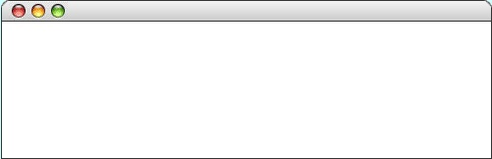

The Towers of Hanoi Solution
int main() {
int nDisks = 3;
initHanoiGraphics(nDisks);
moveTower(nDisks, 'A', 'B', 'C');
return 0;
}
int main() {
int nDisks = 3;
initHanoiGraphics(nDisks);
moveTower(nDisks, 'A', 'B', 'C');
return 0;
}
void moveTower(int n, char start, char finish, char temp) {
if (n == 1) {
moveSingleDisk(start, finish);
} else {
moveTower(n - 1, start, temp, finish);
moveSingleDisk(start, finish);
moveTower(n - 1, temp, finish, start);
}
}
void moveTower(int n, char start, char finish, char temp) {
if (n == 1) {
moveSingleDisk(start, finish);
} else {
moveTower(n - 1, start, temp, finish);
moveSingleDisk(start, finish);
moveTower(n - 1, temp, finish, start);
}
}
void moveTower(int n, char start, char finish, char temp) {
if (n == 1) {
moveSingleDisk(start, finish);
} else {
moveTower(n - 1, start, temp, finish);
moveSingleDisk(start, finish);
moveTower(n - 1, temp, finish, start);
}
}
void moveTower(int n, char start, char finish, char temp) {
if (n == 1) {
moveSingleDisk(start, finish);
} else {
moveTower(n - 1, start, temp, finish);
moveSingleDisk(start, finish);
moveTower(n - 1, temp, finish, start);
}
}
void moveTower(int n, char start, char finish, char temp) {
if (n == 1) {
moveSingleDisk(start, finish);
} else {
moveTower(n - 1, start, temp, finish);
moveSingleDisk(start, finish);
moveTower(n - 1, temp, finish, start);
}
}
void moveTower(int n, char start, char finish, char temp) {
if (n == 1) {
moveSingleDisk(start, finish);
} else {
moveTower(n - 1, start, temp, finish);
moveSingleDisk(start, finish);
moveTower(n - 1, temp, finish, start);
}
}
void moveTower(int n, char start, char finish, char temp) {
if (n == 1) {
moveSingleDisk(start, finish);
} else {
moveTower(n - 1, start, temp, finish);
moveSingleDisk(start, finish);
moveTower(n - 1, temp, finish, start);
}
}
void moveTower(int n, char start, char finish, char temp) {
if (n == 1) {
moveSingleDisk(start, finish);
} else {
moveTower(n - 1, start, temp, finish);
moveSingleDisk(start, finish);
moveTower(n - 1, temp, finish, start);
}
}
nDisks
3
n
start
finish
temp
n
start
finish
temp
'C'
3
'C'
3
'A'
'A'
'B'
n
'B'
n
start
start
finish
finish
temp
temp
'B'
2
'A'
2
'A'
'C'
'C'
n
'B'
n
n
n
start
start
start
start
finish
finish
finish
finish
temp
temp
temp
temp
'C'
'A'
'B'
1
'C'
1
1
1
'A'
'B'
'C'
'A'
'B'
'C'
'A'
'B'
Hanoi
skip simulation

Slide 5
The Recursive “Leap of Faith”
The purpose of going through the complete decomposition of the factorial function is to convince you that the process works and that recursive calls are in fact no different from other method calls, at least in their internal operation.
The danger with going through these details is that it might encourage you to do the same when you write your own recursive programs. As it happens, tracing through the details of a recursive program almost always makes such programs harder to write. Writing recursive programs becomes natural only after you have enough confidence in the process that you don’t need to trace them fully.
As you write a recursive program, it is important to believe that any recursive call will return the correct answer as long as the arguments define a simpler sub-problem. Believing that to be true, even before you have completed the code, is called the recursive leap of faith.

Slide 6
The Subset-Sum Problem
The subset-sum problem can be expressed as follows:
For example, given the set { –2, 1, 3, 8 } and the target value 7, the answer to the subset-sum question is?
Yes, because the subset { –2, 1, 8 } adds up to 7.
What if the target value is 5?
The answer would be no.
This problem is difficult to solve without using recursion, mostly because any solution strategy requires exploring a solution space that doubles in size each time you choose whether to include a particular value from the set in the sum.
Given a set of integers and a target value, determine whether it is possible to find a subset of those integers whose sum is equal to the specified target.

Slide 7
The Subset-Sum Problem
When you are looking for a recursive decomposition, you need to find some value in the inputs—arguments in the C++ formulation of the problem—that you can make smaller.
We can either make the set smaller, or make the target smaller. Which one is the critical metric here?
Given the original set of integers and a smaller target value, determine whether it is possible to find a subset of those integers whose sum is equal to the newly specified target.
Given a subset of the original set of integers and the original target value, determine whether it is possible to find a subset of the subset whose sum is equal to the specified target.

Slide 8
The Subset-Sum Problem
The recursive solution to this problem tries to find a solution that includes a particular element of the set and then tries to find a solution that excludes that element. This strategy is often called the inclusion-exclusion pattern.
The key insight you need to solve this problem is that there are two ways that you might be able to produce the desired target sum after you have identified a particular element.
One possibility is that the subset you’re looking for excludes that element, in which case it must be possible to generate the value target using only the leftover set of elements.
The other possibility is that the subset you’re looking for includes that element. For that to happen, it must be possible to take the rest of the set and produce the value target-element.

Slide 9
Code for the Subset-Sum Program
/*
* Function: subsetSumExists
* Usage: if (subsetSumExists(set, target) . . .
* ---------------------------------------------
* Determines whether it is possible to choose elements from set so that
* the sum is equal to target. The recursion uses the inclusion-exclusion
* pattern. This pattern begins by choosing a particular element (this
* code chooses the first element) and then continues by checking whether
* it is possible to create the target without using that element or
* whether it is possible to include that element and then find a subset
* of the rest that adds up to the target after subtracting the element.
*/
bool subsetSumExists(Set<int> & set, int target) {
if (set.isEmpty()) {
return target == 0;
} else {
int element = set.first();
Set<int> rest = set - element;
return subsetSumExists(rest, target)
|| subsetSumExists(rest, target - element);
}
}

Slide 10
Generating Permutations
A permutation of a collection of elements is simply an ordering of those elements (anagrams in word games).
To generate all permutations of a collection of N items, you can apply the following recursive decomposition:
Choose every element of the N items to be the first element of the permutation.
Add all possible permutations of the remaining N – 1 items to the set of permutations.
For example, the permutations of the string "ABCDE" are:
The character 'A' followed by all permutations of "BCDE".
The character 'B' followed by all permutations of "ACDE".
The character 'C' followed by all permutations of "ABDE".
The character 'D' followed by all permutations of "ABCE".
The character 'E' followed by all permutations of "ABCD".

Slide 11
Code for the Permutations Function
/*
* Function: generatePermutations
* Usage: Set<string> permutations = generatePermutations(str);
* ------------------------------------------------------------
* Returns a set consisting of all permutations of the specified string.
*/
Set<string> generatePermutations(string str) {
Set<string> result;
if (str == "") {
result += "";
} else {
for (int i = 0; i < str.length(); i++) {
char ch = str[i];
string rest = str.substr(0, i) + str.substr(i + 1);
for (string s : generatePermutations(rest)) {
result += ch + s;
}
}
}
return result;
}

Slide 12
Graphical Recursion
Some of the most exciting applications of recursion use graphics to create intricate pictures in which a particular motif is repeated at many different scales.
Graphics libraries, e.g., GWindow, GObject in the Stanford C++ libraries, are needed to implement the following graphical recursion programs.

Slide 13
Methods in the Graphics Library
GWindow gw(width, height)
Creates a graphics window with the specified dimensions.
gw.drawLine(x₀, y₀, x₁, y₁)
Draws a line connecting the points (x₀, y₀) and (x₁, y₁).
gw.drawPolarLine(x₀, y₀, r, theta)
Draws a line r pixels long in direction theta from (x₀, y₀). To make chaining line segments easier, this function returns the ending coordinates as a GPoint.
gw.getWidth()
Returns the width of the graphics window.
gw.getHeight()
Returns the height of the graphics window.
Many more functions exist in the gwindow.h and gobjects.h interfaces. The full documentation is available on the website.
http://stanford.edu/~stepp/cppdoc/

Slide 14
Mondrian Decomposition
Strongly influenced by Cubism, the Dutch painter Piet Mondrian (1872–1944) produced a series of compositions based on horizontal and vertical lines.

Slide 15
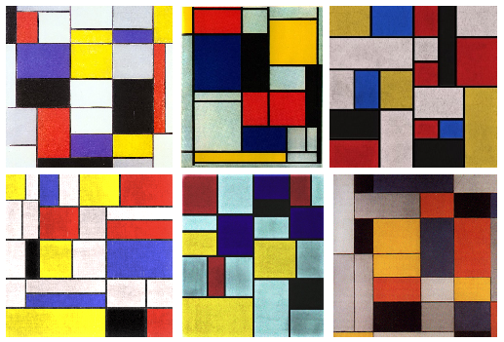
Generating Mondrian-Style Paintings
Fig. 11: Three real Mondrian paintings, and three samples from our targeting function. Can you tell which is which?
Source: Jerry O. Talton, Yu Lou, Steve Lesser, Jared Duke, Radomír Měch, and Vladlen Koltun, “Metropolis Procedural Modeling,” ACM Transactions on Graphics, April 2011.
Notes:
Three images of original Mondrian paintings, and three random samples from our targeting function. Clockwise from top left, the first, second, and fourth images are Mondrians. The paintings are ‘Composition A.’ 1920; ‘Tableau No. II with Red, Blue, Black, Yellow and Grey’ 1921-25; and ‘No. VI / Composition No. II’ 1920, all © 2011 Mondrian/Holtzman Trust c/o HCR - International Virginia.

Slide 16
Code for the Mondrian Program
#include <iostream>
#include "gwindow.h"
#include "random.h"
using namespace std;
/* Constants */
const double MIN_AREA = 10000; /* Smallest square that will be split */
const double MIN_EDGE = 20; /* Smallest edge length allowed */
/* Function prototypes */
void subdivideCanvas(GWindow & gw, double x, double y,
double width, double height);
/* Main program */
int main() {
GWindow gw;
subdivideCanvas(gw, 0, 0, gw.getWidth(), gw.getHeight());
return 0;
}
Page 1 of 2

Slide 17
Code for the Mondrian Program
void subdivideCanvas(GWindow & gw, double x, double y,
double width, double height) {
if (width * height >= MIN_AREA) {
if (width > height) {
double mid = randomReal(MIN_EDGE, width - MIN_EDGE);
subdivideCanvas(gw, x, y, mid, height);
subdivideCanvas(gw, x + mid, y, width - mid, height);
gw.drawLine(x + mid, y, x + mid, y + height);
} else {
double mid = randomReal(MIN_EDGE, height - MIN_EDGE);
subdivideCanvas(gw, x, y, width, mid);
subdivideCanvas(gw, x, y + mid, width, height - mid);
gw.drawLine(x, y + mid, x + width, y + mid);
}
}
}
#include <iostream>
#include "gwindow.h"
#include "random.h"
using namespace std;
/* Constants */
const double MIN_AREA = 10000; /* Smallest square that will be split */
const double MIN_EDGE = 20; /* Smallest edge length allowed */
/* Function prototypes */
void subdivideCanvas(GWindow & gw, double x, double y,
double width, double height);
/* Main program */
int main() {
GWindow gw;
subdivideCanvas(gw, 0, 0, gw.getWidth(), gw.getHeight());
return 0;
}
In graphical recursion, there seems to be no simple cases to be solved.
There must be, however, some stopping criteria to stop the recursion.
Page 2 of 2

Slide 18
Exercise: A Better Mondrian Program
Can you do a better job of emulating Mondrian’s style?
Suppose that you have the following additional functions:
gw.drawRect(x, y, width, height)
Draws the outline of a rectangle with the specified bounds.
gw.fillRect(x, y, width, height)
Fills the outline of the specified rectangle using the current color.
gw.setColor(color)
Sets the pen color to the specified color string (such as "BLACK" or "RED")
gw.setColor("#rrggbb")
Sets the red/green/blue components to the specified hexadecimal values.

Slide 19
Revised Mondrian Decomposition

Slide 20
Graphical Recursion
Recursion comes up in many graphical applications, most notably in the creation of fractals, which are mathematical structures consisting of similar figures at various different scales. Fractals were popularized in a 1982 book by the late Benoit Mandelbrot (1924-2010) entitled The Fractal Geometry of Nature.
One of the simplest fractal patterns to draw is the Koch fractal, named after its inventor, the Swedish mathematician Helge von Koch (1870-1924). The Koch fractal is sometimes called a snowflake fractal because of the beautiful, six-sided symmetries it displays as the figure becomes more detailed. as illustrated in the following diagram:

Slide 21
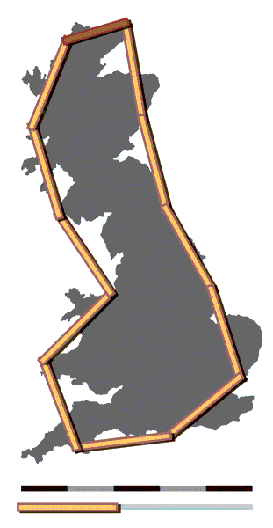
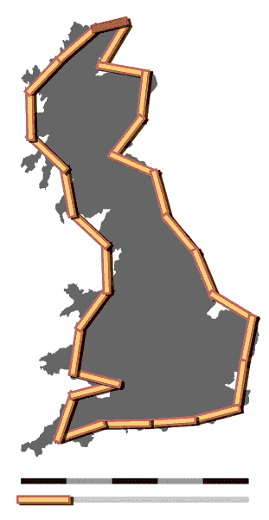
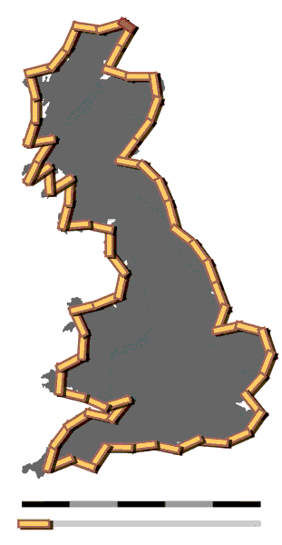

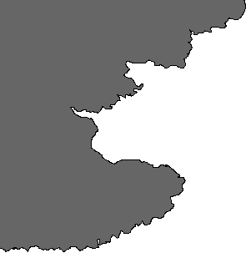
How Long is the Coast of England?
The first widely circulated paper about fractals was a 1967 article in Science by Mandelbrot that asked the seemingly innocuous question, “How long is the coast of England?”
The point that Mandelbrot made in the article is that the answer depends on the measurement scale, as these images from Wikipedia show.
This thought-experiment serves to illustrate the fact that coastlines are fractal in that they exhibit the same structure at every level of detail.
200km ruler
100km ruler
50km ruler

Slide 22
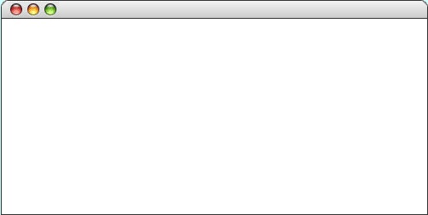
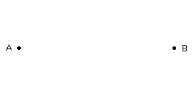
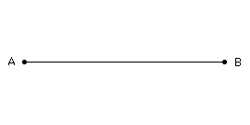
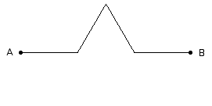
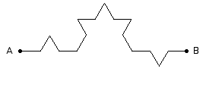
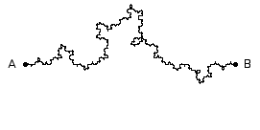
Exercise: Fractal Coastline
Exercise 15 on page 384 asks you to draw a fractal coastline between two points, A and B, on the graphics window.
The order-0 coastline is just a straight line.
The order-1 coastline replaces that line with one containing a triangular wedge pointing randomly up or down.
The order-2 coastline does the same for each line in the order-1.
Repeating this process eventually yields an order-5 coastline.
Coastline

Slide 23
The End

